Slide 1
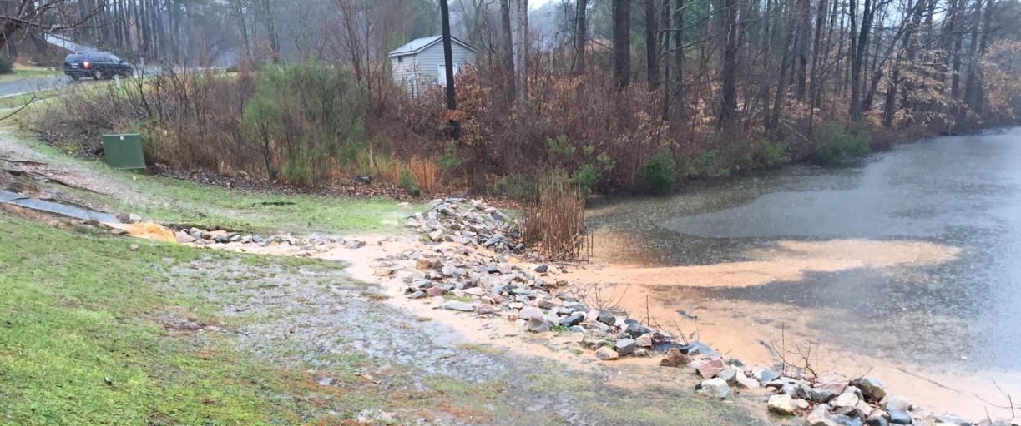
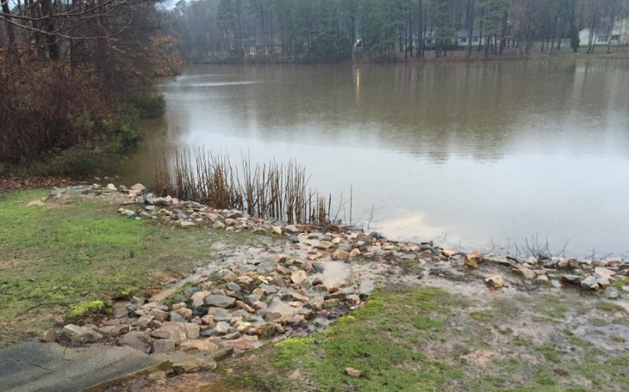
4 Feb 2016 To: Raleigh Stormwater Inspections Section From: Springdale Estates Lake Committee Re: Erosion from the bare soil and bare piles of fill on 8619 ONeal Road into Lower Springdale Estates Lake. Dear Raleigh Stormwater Inspection Service: We continue to be concerned about the adverse impact of the continued soil erosion from 8619 ONeal Road on our Lower Springdale Estates Lake and from there on Hare Snipe Creek. Yesterday and today’s rain event resulted in yet another erosion event which is documented in these photos. The route that most of this eroded soil travels unimpeded is off 8619 ONeal Road into the drainage culvert along ONeal Road and from there directly into the Lake (see photos); this path bypasses the sedimentation barrier erected along the Lake shore. Sincerely. Van Cotter for The Springdale Estates Lake Committee
Delta of sediment from the erosion.
8619 ONeal Road
4 Feb 2016
Late in the rain storm. Erosion has changed the color of the entire Lake.
3 Feb 2016
Early in the rain storm showing erosion from 8619 ONeal into Lower Springdale Lake.

Slide 2
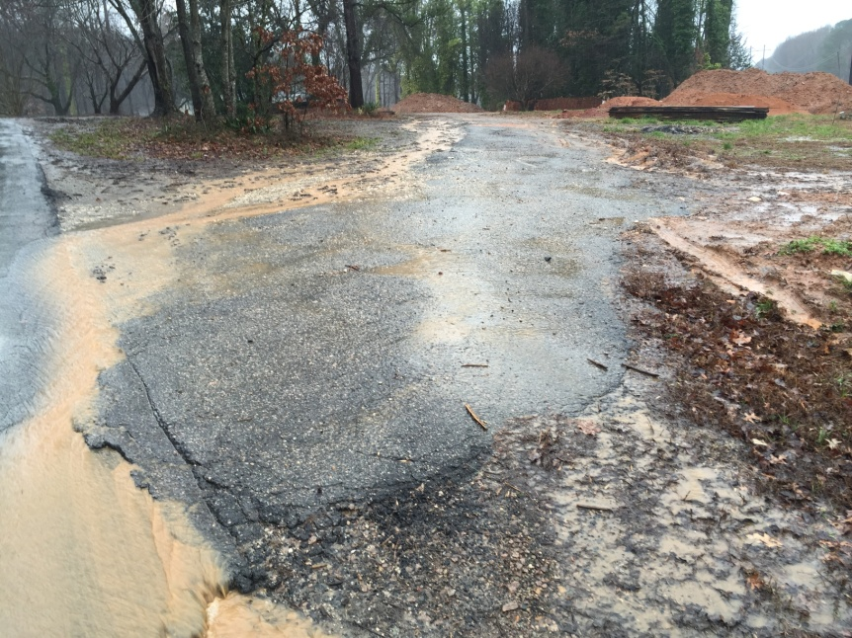
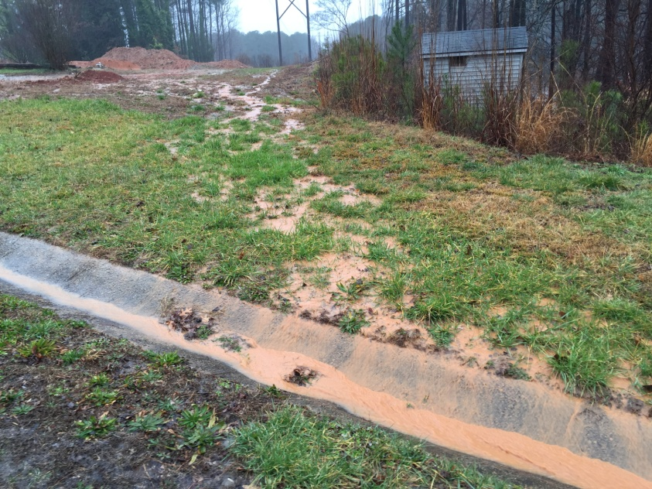
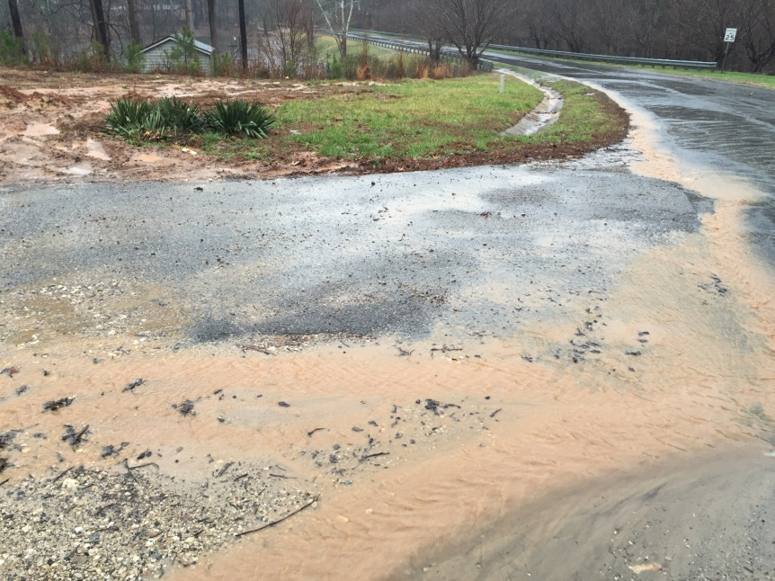
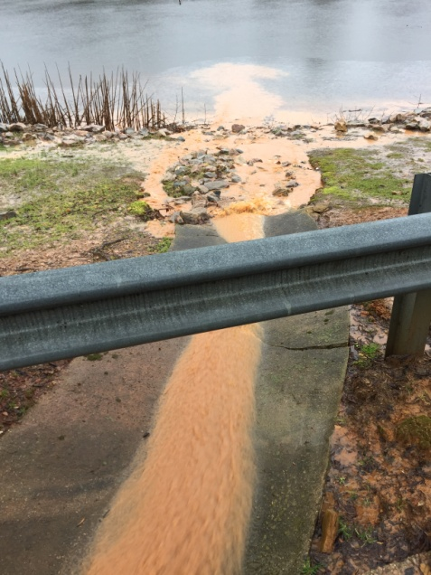
Erosion from the bare soil and bare piles of fill on 8619 ONeal Road into Lower Springdale Estates Lake. 3 Feb 2016.
Soil eroding unimpeded off 8619 ONeal onto ONeal Road and into culvert along ONeal Road.
Eroded soil continuing unimpeded down ONeal and then into Lower Springdale Lake.

Slide 3
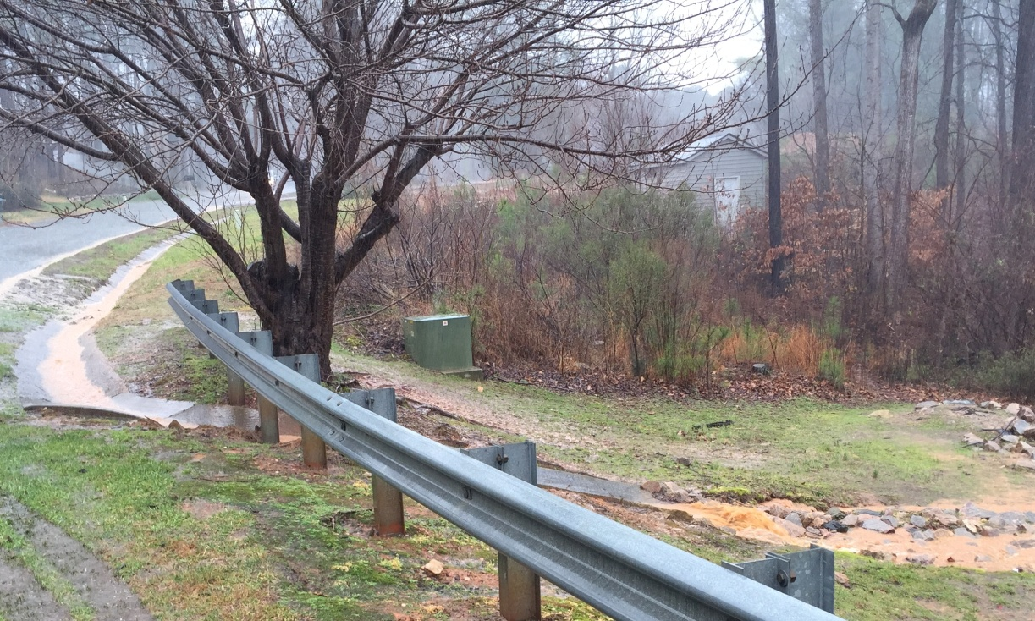
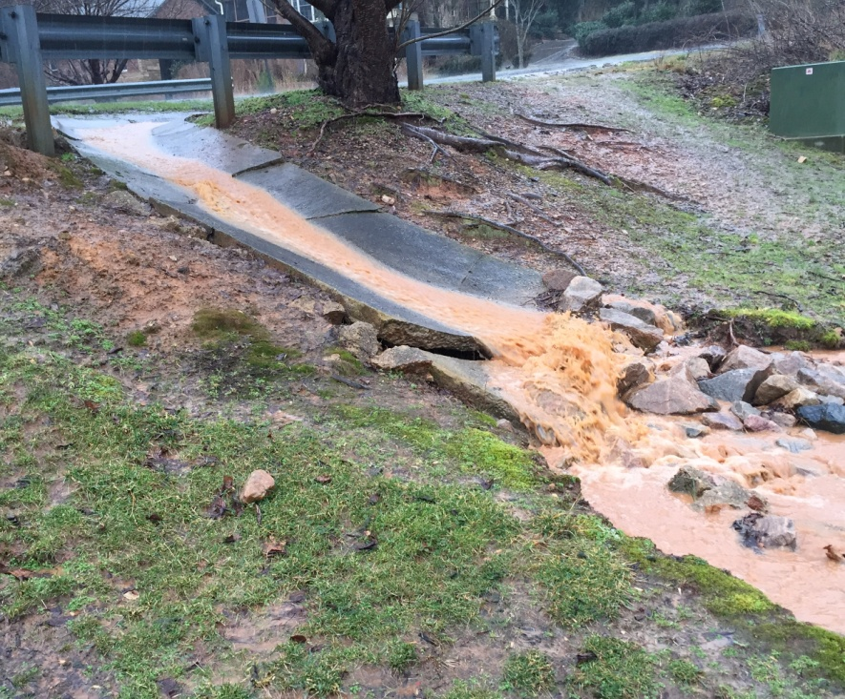
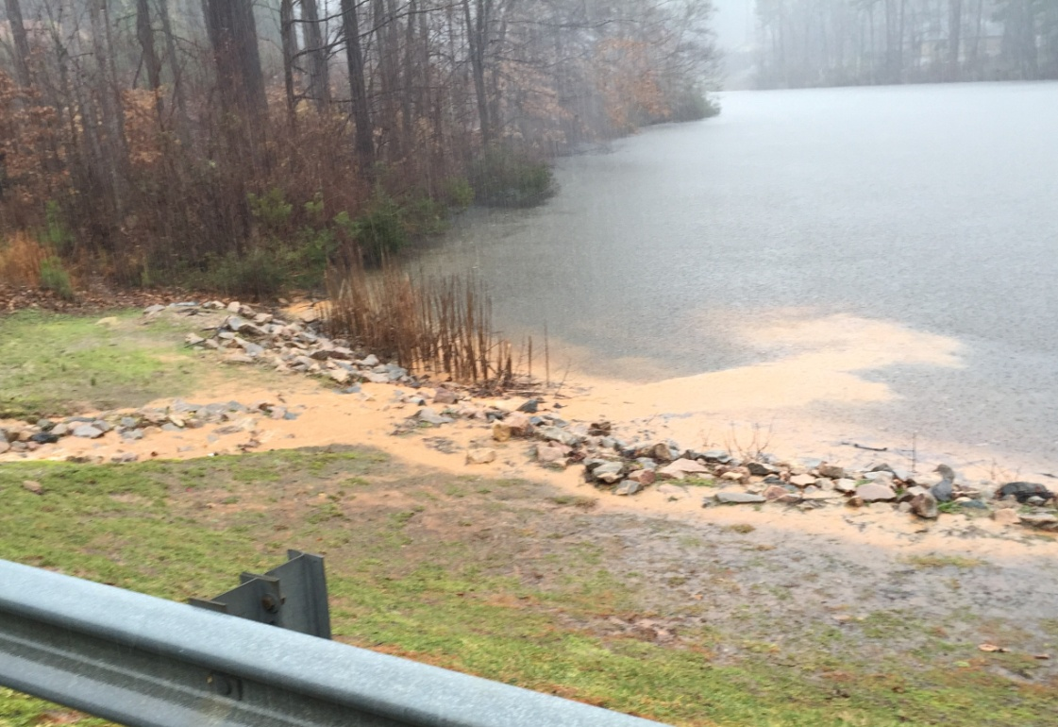
Erosion from the bare soil and bare piles of fill on 8619 ONeal Road into Lower Springdale Estates Lake. 3 Feb 2016.

